Slide 1

Presentation Materials Created by Mimetics Inc.
Free use by anyone for non-commercial purposes
Copyrights, Trademarks and other Registered Marks the Property of their Owners

Slide 2
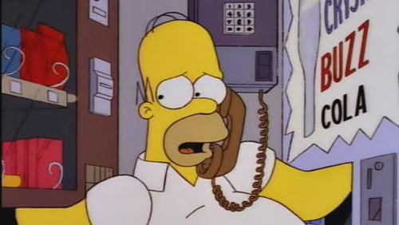
Grade 8 Systems - Class 5
Using Variables
and Comparisons
Notes:
We want to introduce the Jade Robot and it’s Tools in more detail along with our action plans for it.
It’s interesting, but it’s easy to criticize something when it’s done (especially when you have experience) – a *LOT* more difficult getting it right from the start. Also, preparing this presentation was a great way to review and think about what we should be doing.

Slide 3

Recap
What is Programming?
What is a Comparison Operation and what values are returned?
What are the Output and Input Values used on the Jade Robot?
Notes:
Can Demo Jade Scratch if people are interested. In doing this product I’ve had a few interesting discoveries – one was going with a simpler programming language actually has a *LOT* of value for an expert like myself.

Slide 4
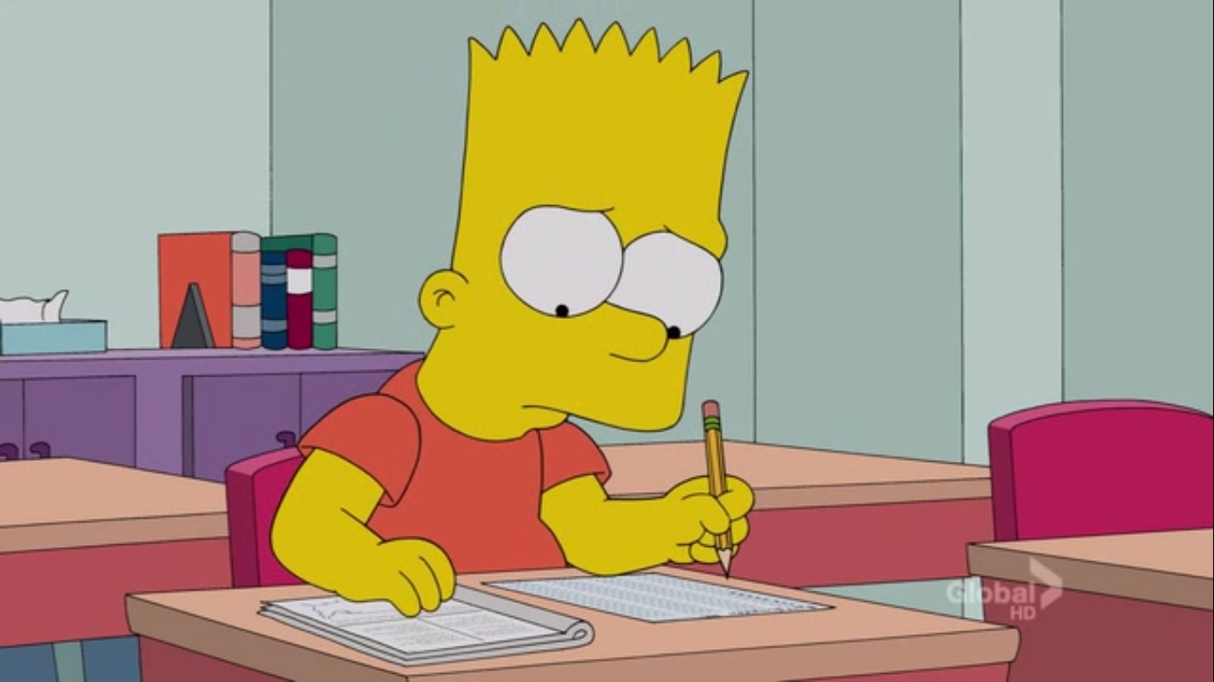
Hint for Copying
Programs…
Notes:
Can Demo Jade Scratch if people are interested. In doing this product I’ve had a few interesting discoveries – one was going with a simpler programming language actually has a *LOT* of value for an expert like myself.

Slide 5
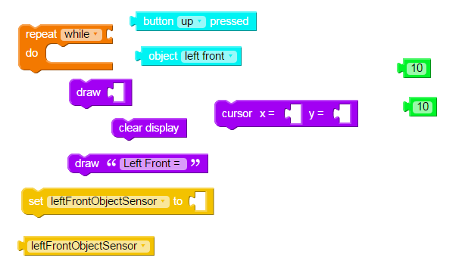
Hint for Copying…
DON’T Load Blocks First
Copy Program in Order
Notes:
Can Demo Jade Scratch if people are interested. In doing this product I’ve had a few interesting discoveries – one was going with a simpler programming language actually has a *LOT* of value for an expert like myself.

Slide 6
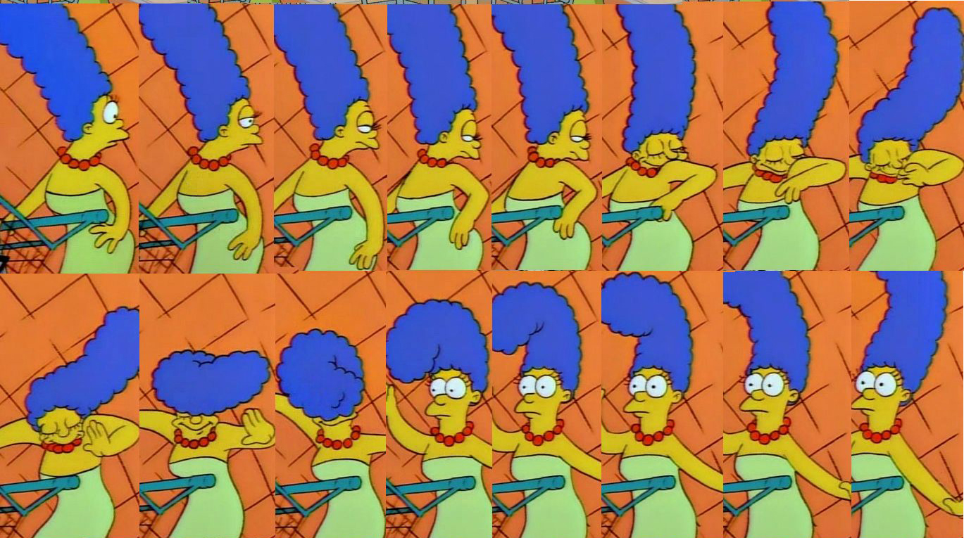
Think in terms of SEQUENCE!
Hint for Copying…
Notes:
Can Demo Jade Scratch if people are interested. In doing this product I’ve had a few interesting discoveries – one was going with a simpler programming language actually has a *LOT* of value for an expert like myself.

Slide 7
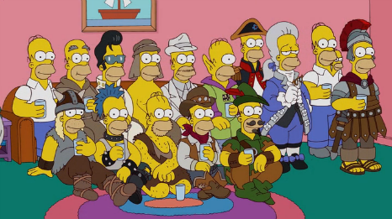
Variables
Notes:
Can Demo Jade Scratch if people are interested. In doing this product I’ve had a few interesting discoveries – one was going with a simpler programming language actually has a *LOT* of value for an expert like myself.

Slide 8

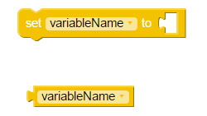
Things to Know About Scratch Variables
Initialize/Save Data in “variable” FIRST
Get Saved Data in “variable”
Variable Stores Integer Data
Variable Name Starts with “_”, “a”-”z”, “A”-”Z”
Notes:
Can Demo Jade Scratch if people are interested. In doing this product I’ve had a few interesting discoveries – one was going with a simpler programming language actually has a *LOT* of value for an expert like myself.

Slide 9
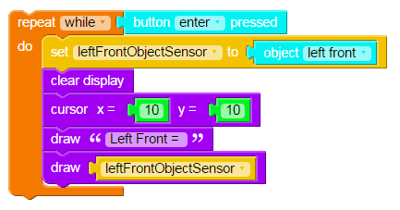
Var4
Notes:
Can Demo Jade Scratch if people are interested. In doing this product I’ve had a few interesting discoveries – one was going with a simpler programming language actually has a *LOT* of value for an expert like myself.

Slide 10
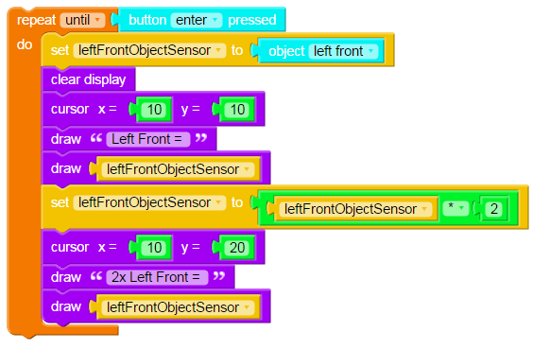
Var5
Notes:
Can Demo Jade Scratch if people are interested. In doing this product I’ve had a few interesting discoveries – one was going with a simpler programming language actually has a *LOT* of value for an expert like myself.

Slide 11
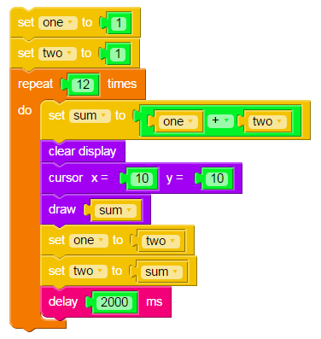
Var6
Repeating Calculation is:
sum = sumPrevious + sum2Previous
What does the
final Number
Represent?
Notes:
Can Demo Jade Scratch if people are interested. In doing this product I’ve had a few interesting discoveries – one was going with a simpler programming language actually has a *LOT* of value for an expert like myself.

Slide 12
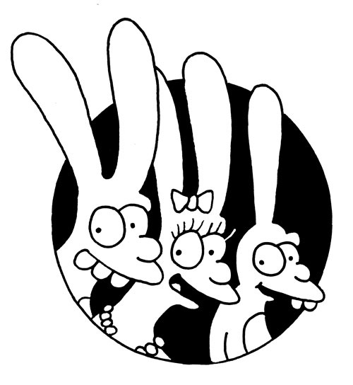
The Number of Rabbits
After Unrestricted Breeding
For One Year
Rabbits take 1 Month to mature and has two offspring every month
Known as the “Fibonacci Sequence”
Notes:
Can Demo Jade Scratch if people are interested. In doing this product I’ve had a few interesting discoveries – one was going with a simpler programming language actually has a *LOT* of value for an expert like myself.

Slide 13
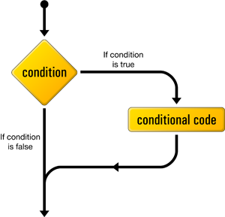
“if” Operations
Notes:
We clone a community project into “My Projects” so we can make changes to it without affecting all the “Community Projects”

Slide 14

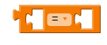
Comparison Operators
“Equals” is A = B
“Not Equals” is A ≠ B
“Less Than” is A < B
“Less Than or Equals” is A ≤ B
“Greater Than” is A > B
“Greater Than or Equals” is A ≥ B
Notes:
Can Demo Jade Scratch if people are interested. In doing this product I’ve had a few interesting discoveries – one was going with a simpler programming language actually has a *LOT* of value for an expert like myself.

Slide 15

True & False
“True” is an Non-Zero Integer
“False” is Zero
Notes:
Can Demo Jade Scratch if people are interested. In doing this product I’ve had a few interesting discoveries – one was going with a simpler programming language actually has a *LOT* of value for an expert like myself.

Slide 16
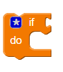
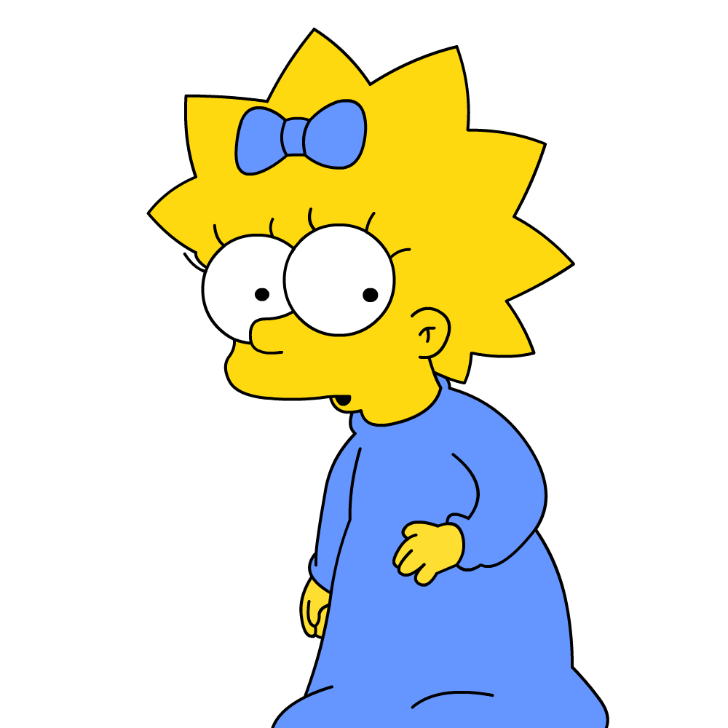
“if” Statement
If Value ≠ 0
Do This
Notes:
Can Demo Jade Scratch if people are interested. In doing this product I’ve had a few interesting discoveries – one was going with a simpler programming language actually has a *LOT* of value for an expert like myself.

Slide 17
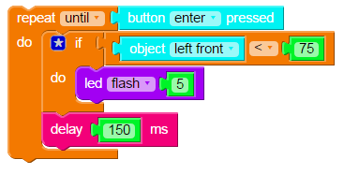
Decide Whether or Not to Do Something
if1
Notes:
Can Demo Jade Scratch if people are interested. In doing this product I’ve had a few interesting discoveries – one was going with a simpler programming language actually has a *LOT* of value for an expert like myself.

Slide 18

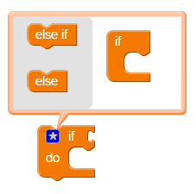
“if” Statement Expansion
Drag “Else” Into “if”
Click Star to Add Options
Notes:
Can Demo Jade Scratch if people are interested. In doing this product I’ve had a few interesting discoveries – one was going with a simpler programming language actually has a *LOT* of value for an expert like myself.

Slide 19
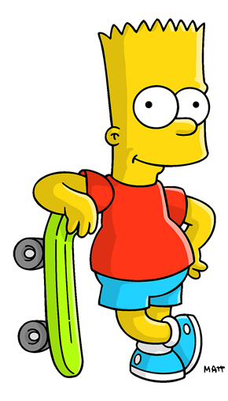
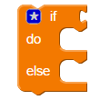
“if-else” Statement
If Value ≠ 0
Do This
Else, Do This
Notes:
Can Demo Jade Scratch if people are interested. In doing this product I’ve had a few interesting discoveries – one was going with a simpler programming language actually has a *LOT* of value for an expert like myself.

Slide 20
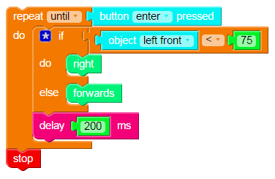
if2
Notes:
Can Demo Jade Scratch if people are interested. In doing this product I’ve had a few interesting discoveries – one was going with a simpler programming language actually has a *LOT* of value for an expert like myself.

Slide 21
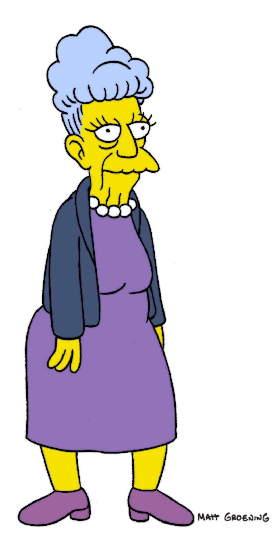
Challenge
Create a program that:
Repeat Until “Enter” Button Pressed
Draw Left & Right Front Object Values
if Left Front Object Sensor < 75
Turn Right for 200ms
else if Right Front Object Sensor < 75
Turn Left for 200ms
else
Go Forwards for 200ms
Notes:
Can Demo Jade Scratch if people are interested. In doing this product I’ve had a few interesting discoveries – one was going with a simpler programming language actually has a *LOT* of value for an expert like myself.

